Slide 1
Spirometric Obstruction COPD Diagnosis
Brian Locke MD MSCI
Assistant Professor of Research
Department of Pulmonary and Critical Care
Intermountain Medical Center
Disclosures:
Research support from the Intermountain Fund, American Thoracic Society, NIH
Equity in theMTN.ai , time-series machine learning for patient monitoring

Slide 2
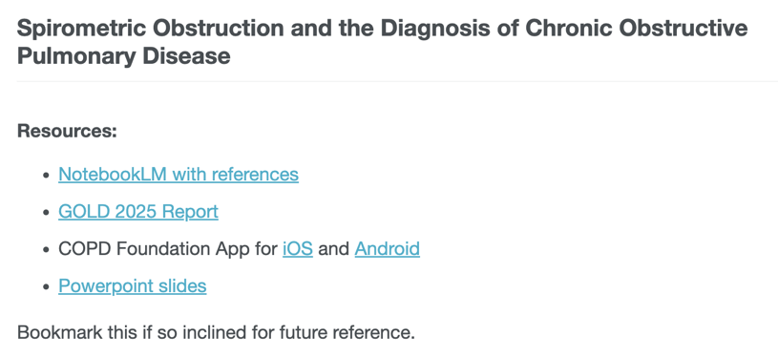


Slide 3
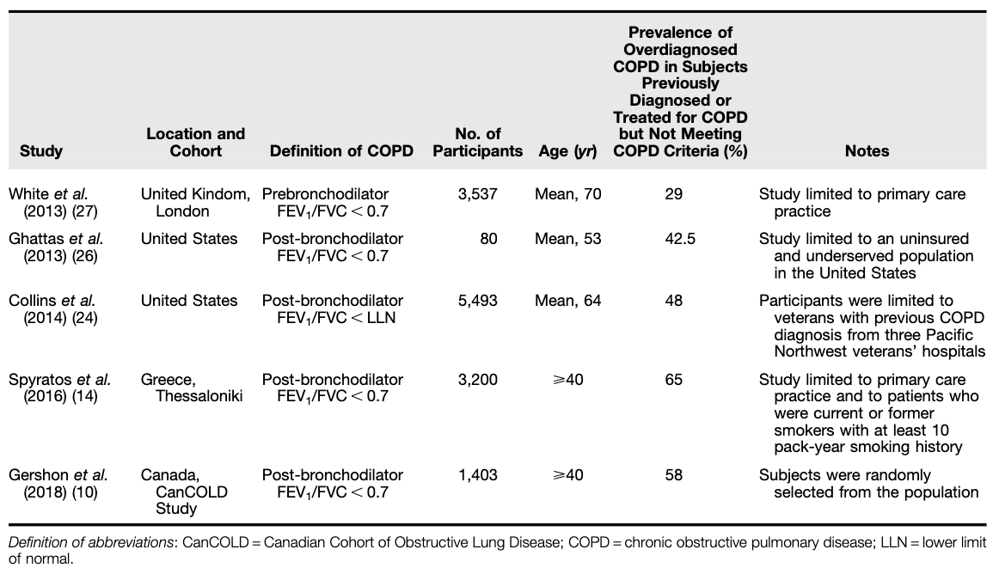
Most COPD diagnoses are wrong.
Misdiagnosed

Slide 4
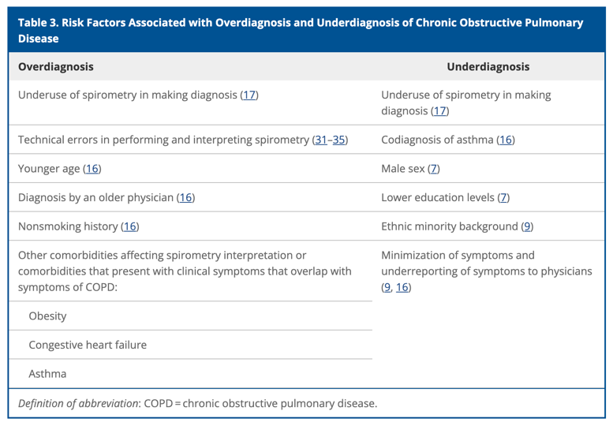
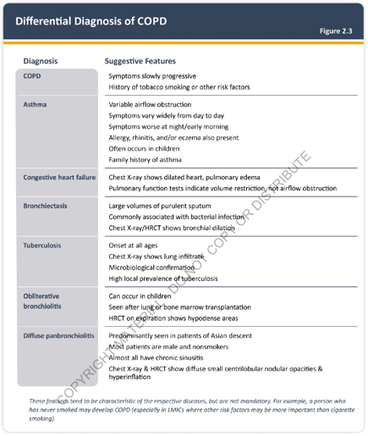
Misdiagnosis
Misdiagnosis
Notes:
Treatments for COPD are generally pretty benign – so the main downside of this is that when the diagnosis is wrong, the real diagnosis is probably not being effectively addressed.

Slide 5
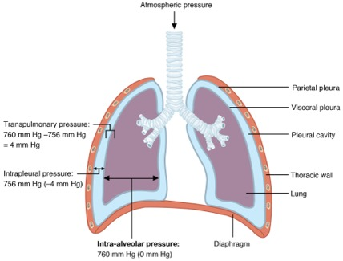
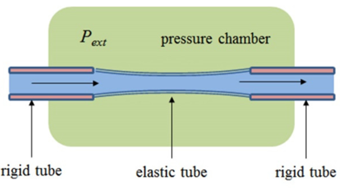
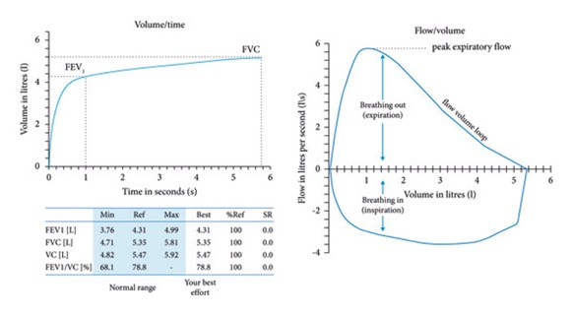
What is obstruction?
Starling Resistor
Effort-independent
Effort-independent
Spirogram
Flow-volume loop
Notes:
Blow as hard as you can

Slide 7

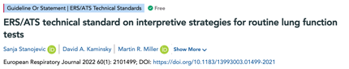

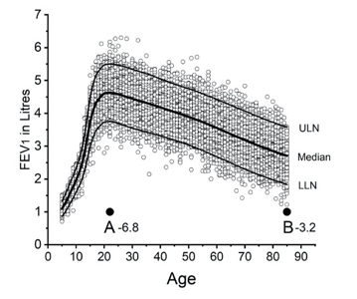
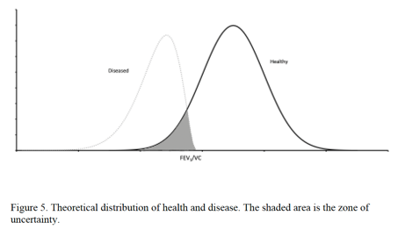
Dichotomizing a continuous measure
Obstruction == FEV1/FVC < LLN
for age, sex, height
Obstruction == FEV1/FVC < 0.70
Not “<70% predicted”!

Slide 8
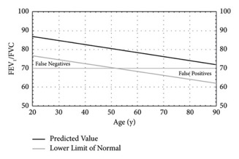
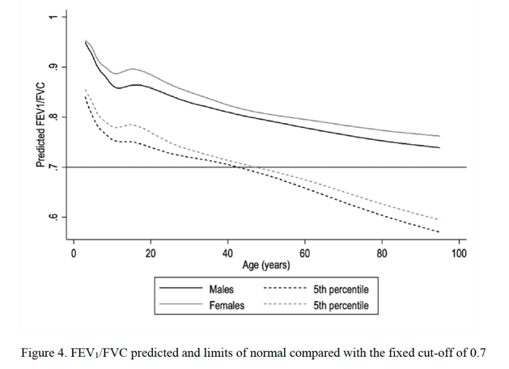
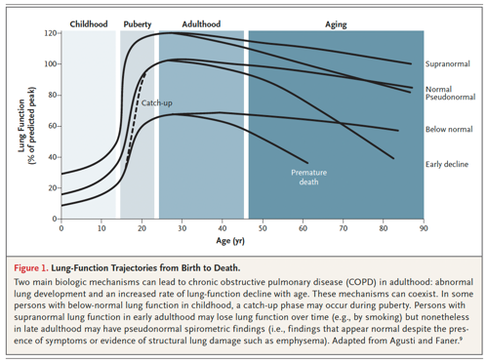
Over-diagnose the old, under-diagnose the young?

Slide 9
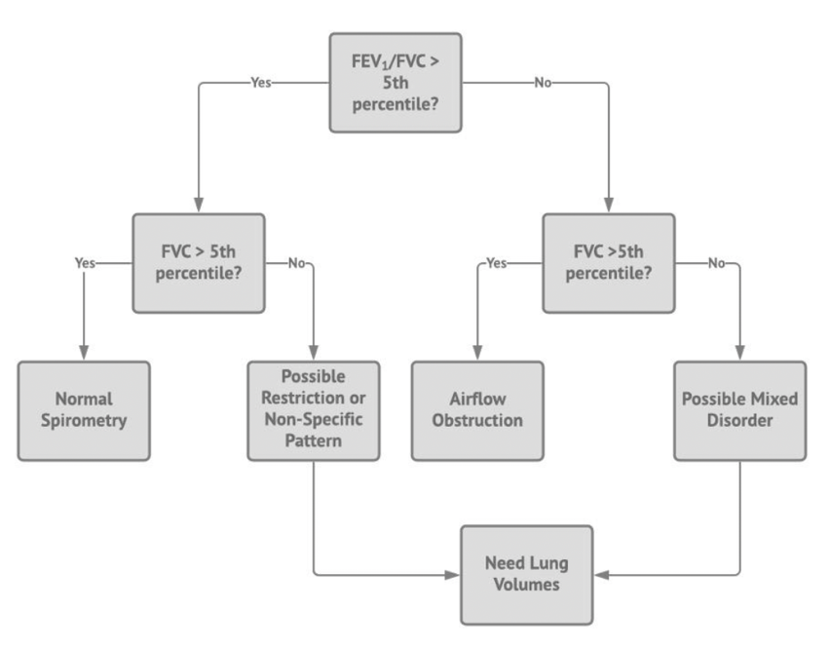
Or < 0.7 if using GOLD
Notes:
GLI calc: https://gli-calculator.ersnet.org/index.html

Slide 10
Example 1
30-year-old male; 5 ft 6
 | Pre | %Predicted | LLN | Post | %Predicted | LLN
FVC | 3.5L | 81.0% | 3.36
FEV1 | 2.75 | 68.5% | 2.84
FEV1/FVC | 0.714 | 84.5% | 0.74
Obstruction (GOLD)?
Obstruction (GLI)?

Slide 11
Example 1
30-year-old male; 5 ft 6
 | Pre | %Predicted | LLN | Post | %Predicted | LLN
FVC | 3.5L | 81.0% | 3.36
FEV1 | 2.75 | 68.5% | 2.84
FEV1/FVC | 0.714 | 84.5% | 0.74
Obstruction (GOLD)? No (above 0.7)
Obstruction (GLI)? Yes (below 0.74)

Slide 12
Example 2
80-year-old female; 5 ft 6
 | Pre | %Predicted | LLN | Post | %Predicted | LLN
FVC | 3.5L | 116% | 1.91
FEV1 | 2.75 | 120% | 1.42
FEV1/FVC | 0.714 | 92.3% | 0.639
Obstruction (GOLD)?
Obstruction (GLI)?

Slide 13
Example 2
80-year-old female; 5 ft 6
 | Pre | %Predicted | LLN | Post | %Predicted | LLN
FVC | 3.5L | 116% | 1.91
FEV1 | 2.75 | 120% | 1.42
FEV1/FVC | 0.714 | 92.3% | 0.639
Obstruction (GOLD)? No (Above 0.7)
Obstruction (GLI)? No (Above 0.639)

Slide 14
Example 3
80-year-old female; 5 ft 6
 | Pre | %Predicted | LLN | Post | %Predicted | LLN
FVC | 1.8L | 65% | 1.91
FEV1 | 1.25 | 60% | 1.42
FEV1/FVC | 0.69 | 89.7% | 0.639
Obstruction (GOLD)?
Obstruction (GLI)?

Slide 15
Example 3
80-year-old female; 5 ft 6
 | Pre | %Predicted | LLN | Post | %Predicted | LLN
FVC | 1.8L | 65% | 1.91
FEV1 | 1.25 | 60% | 1.42
FEV1/FVC | 0.69 | 89.7% | 0.639
Obstruction (GOLD)? Yes (below 0.7)
Obstruction (GLI)? No (above 0.64)
(has restriction, FVC < 1.91)

Slide 16
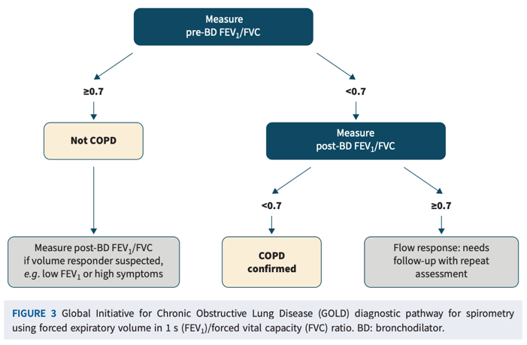
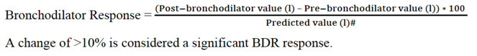
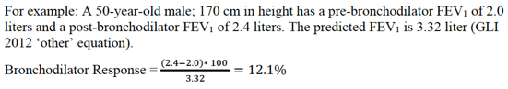
Post-Bronchodilator vs Bronchodilator Response
BD-response (10%+) or not has NO ROLE IN DIAGNOSING COPD OR ASTHMA
Not predictive of COPD vs Asthma
Does portend worse trajectory

Slide 17
Example 4
80-year-old female; 5 ft 6
 | Pre | %Predicted | LLN | Post | %Predicted | LLN
FVC | 1.8L | 65% | 1.91 | 2.0L | 71% | 1.91
FEV1 | 1.25 | 60% | 1.42 | 1.4L | 67% | 1.42L
FEV1/FVC | 0.69 | 89.7% | 0.639 | 0.71 | 92% | 0.639
Post-BD Obstruction (GOLD)?
Post-BD Obstruction (GLI)?

Slide 18
Example 4
80-year-old female; 5 ft 6
 | Pre | %Predicted | LLN | Post | %Predicted | LLN
FVC | 1.8L | 65% | 1.91 | 2.0L | 71% | 1.91
FEV1 | 1.25 | 60% | 1.42 | 1.4L | 67% | 1.42L
FEV1/FVC | 0.69 | 89.7% | 0.639 | 0.71 | 92% | 0.639
Post-BD Obstruction (GOLD)? No
Post-BD Obstruction (GLI)? No
(has PRISM)

Slide 19
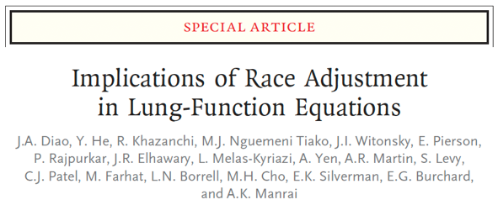

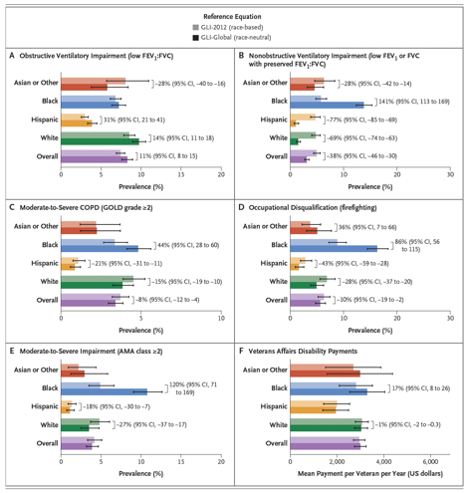
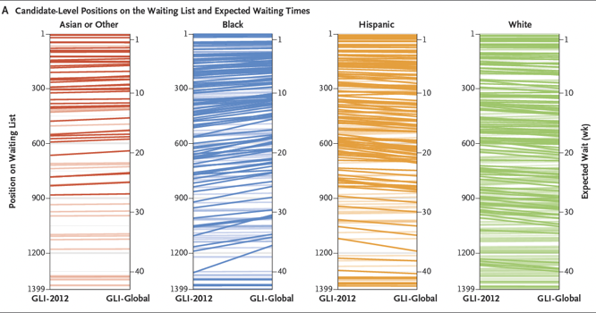
Notes:
Race-differences may largely – but not entirely – reflect systematic inequities rather than expected group norms with equal
Furthermore, defining race is problematic and has a poor track record.
So, have moved to using race neutral equations.
Some positive impacts for disadvantaged groups (e.g. Black patients w more transplant access, but many more disqualified from Firefighting)

Slide 20
Summary (Part 1)
Obstruction occurs because after the initial burst, we don’t volitionally control our exhalation speed – depends on lung mechanics
An FEV1/FVC that is too low defines obstruction
The exact threshold is arbitrary, debatable
Post-BD FEV1/FVC defines diagnoses, but BD response has no role in diagnosis.

Slide 21
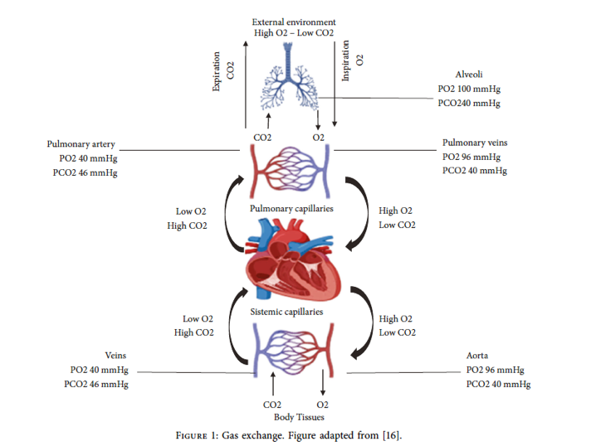
What’s the weakest link?
Notes:
cardiac vs pulmonary limitation
—> implication, in most people, lungs can degrade in performance before limiting. Possible to have asymptomatic flow limitation. Especially if you’re not very cardiovascularly fit.

Slide 22
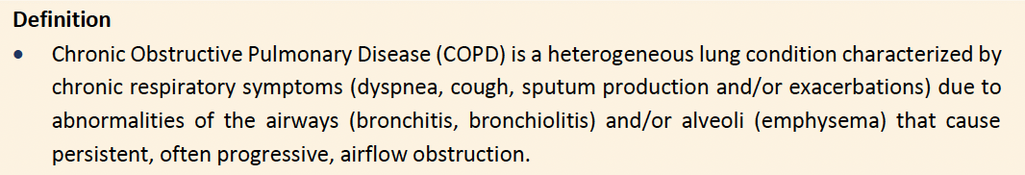
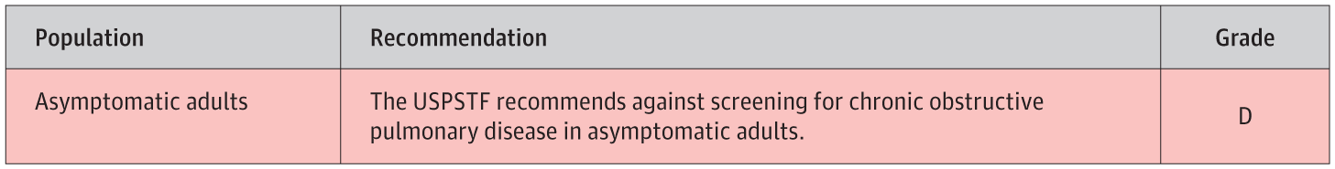
Implication: impaired lung function doesn’t always cause dyspnea (on exertion)
Warning: air hunger is extremely aversive; people will modify their behavior to avoid it and not realize they have excess dyspnea on exertion.

Slide 23
COPD: chronic bronchitis or emphysema
Chronic Bronchitis
Emphysema
???
COPD
Post-BD Airway Obstruction

Slide 24
COPD: chronic bronchitis or emphysema
Post-BD Airway Obstruction
Chronic Bronchitis: cough with expectorated sputum on a regular basis for 3-months per year over a 2-year period in the absence of another condition that explains the symptoms.
Emphysema: alveolar destruction that leads to loss of elastic recoil of the lung (slower emptying), reduced gas diffusing capacity.
- Emphysema without obstruction: ”Pre-COPD”
COPD: Post-BD Airway Obstruction in the presence of irreversible damage
COPD
Emphysema
Chronic Bronchitis
Notes:
Other post-bd airway obstruction? Asthma, bronchiectasis, asymptomatic spirometric obstruction
Emphysema without obstruction? Pre-COPD
Chronic Bronchitis present in about 30% of people with

Slide 25
Scenario 1:
50F with prior smoking history (15 years) presents to clinic with shortness of breath limiting her exertion. PFTs show post-BD obstruction on PFTs. There is a positive BD response.
What data can you gather to tell if the patient has COPD or Asthma?

Slide 26
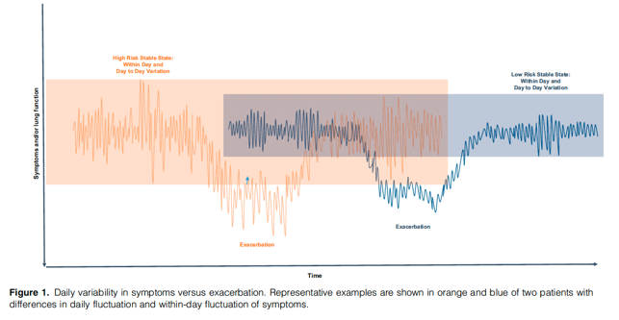
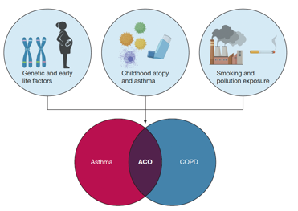
Scenario 1:
BD-response (10%+) or not has NO ROLE IN DIAGNOSING COPD OR ASTHMA
Not predictive of COPD vs Asthma
Does portend worse trajectory
Comorbidities (eczema, allergic rhinitis, EoE/GERD)
Presence (or absence) of detectable emphysema
DLCO (often high in asthma, low in COPD)
Day-to-day variation (esp with exposures)

Slide 27
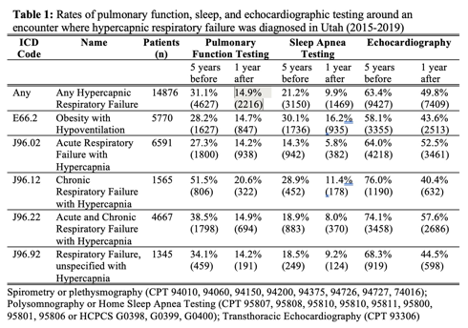
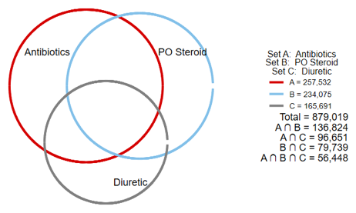
Scenario 1:
65M current smoker presents w 7d of worsening shortness of breath and productive cough. No prior PFTs. Is this an acute exacerbation of COPD?
In patients with hypercapnic respiratory failure…

Slide 28
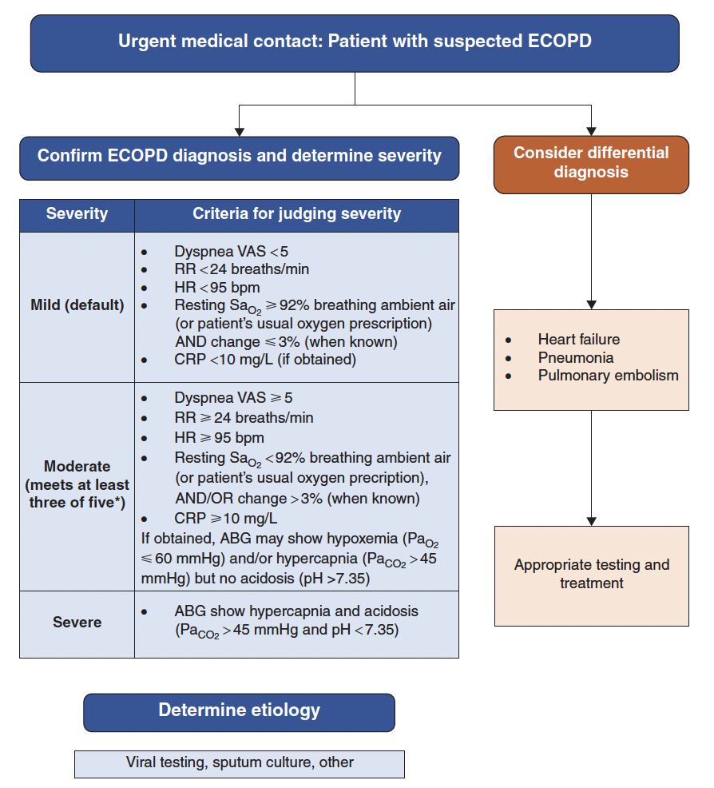
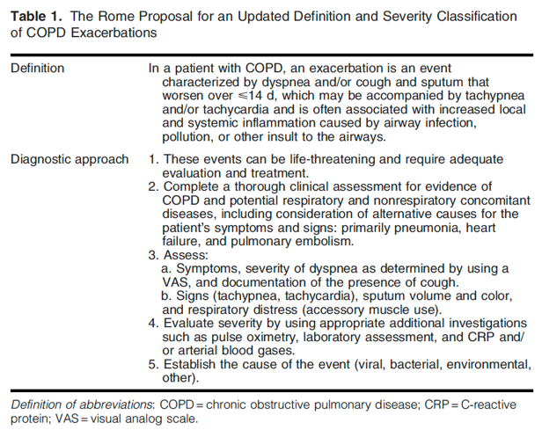

Slide 29

Questions?
Email: brian.locke@imail.org

